Slide 1


Nuvei overview
Payments designed to accelerate your growth
2025

Slide 2









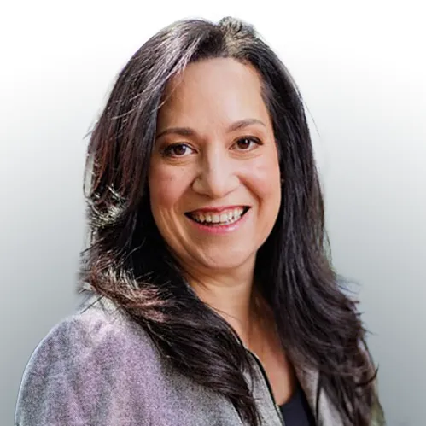





Nuvei executive team
Philip Fayer
Chairman & Chief Executive Officer
Danielle Holbrook Dunn
Chief Transformation Officer
Scott Calliham
SVP, M&A and Strategy
Caitlin Shetter
Chief People
Officer
David Schwartz
Chief Financial Officer
Yuval Ziv
President
Moshe Selfin
Chief Product & Technology
Officer
Neil Erlick
Chief Corporate
Development Officer
Laura Miller
Chief Revenue
Officer & Global Head of eCommerce
Lindsay Matthews
General Counsel & Corporate Secretary
Chad Gerhardstein
Chief Risk & Compliance Officer
Guillaume Conteville
Chief Marketing
Officer
Max Attias
Chief Information
Officer
Notes:
+9%

Slide 3






Gov Leadership Team
Philip Fayer
Chairman & Chief Executive Officer
Yuval Ziv
President
Ben Weiner
Senior Vice President, B2B & Gov
Gregg Bavisotto
Vice President of Sales - Government
Carin Obad
Vice President, Gov Product Strategy & Customer Success
3

Slide 4



Nuvei at a glance
Montreal, HQ Tel-Aviv Innovation Tech Hub
200+
Global
Markets
20+
Global
Offices
50+
Local Acquiring
Markets
700+
Payment
Methods
~150
Currencies
2,800+
Team Members
Our offices
Montreal
Atlanta
Bogota
London
Sofia
Dubai
Petaling Jaya
Vilnius
Ontario
Scottsdale
São Paulo
Amsterdam
Nicosia
Hong Kong
Singapore
4
Chicago
Mexico City
Buenos Aires
Milan
Tel Aviv
Tokyo
Sydney
Notes:
This slide quickly displays the many countries that Nuvei operates in and some basic statistics on our markets. This includes over 200 global markets and 150 different currencies!
Nuvei has multiple office locations across 19 countries and we continue to look to expand over time. Nuvei started in Canada back in 2003, expanded to the US and then moved into the global market starting off in 10 countries and not to 19, its been exciting to be a part of the growth and to have you join us on our journey ahead.

Slide 5








Our purpose
Accelerating our client’s operations
How We Do It
By being innovative, agile, and industry focused, we provide the payment technology and insights our partners, clients, and customers need to succeed nationwide with one integration.
3500+ Agencies & Municipalities Served
35+ States Served
8M+ Payments Processed
$2.5B Volume Processed Annually
350+ Integration Partners
35+ Years of Expertise

Slide 6




What our customers have to say about us
“Historically, our department took all payments for the City of Belen, so we desperately needed an easier system. With more people paying online it allow us to server all customers more effectively and take better care of all our citizens. The new platform has been so successful, other departments are now jumping on board to use the technology.”
- Daniel Carbajal, Finance Director
“We’ve had big growth in online payments, and we really do enjoy working with Nuvei.”
- Sarah Wright, Customer Service Manager
“Changing our bill presentment was a game-changer for us in mitigating customer complaints. We couldn’t have done it without Nuvei.”
- Jessica Dovale, Utility Support Service Manager
“We have happier customers. They’re happy with our payment solution, and we’re happy with it.”
- Everett Bolin, General Manager
6
Notes:
These are direct quotes from our customers.

Slide 7




3 reasons our customers love us
Client’s
Revenue acceleration
Platform flexibility
On-demand, human-led, government expertise
7
Notes:
These are the three things that set us apart from our competition and what in turn our customers love most about us.
Revenue acceleration:
Our mission is to accelerate our customers’ business and our revenue acceleration platform offers advanced authorization tools for fully optimized payments. Some examples of success within our revenue acceleration platform include:
• Switching from legacy systems to our modern payment platform increased North American approval rates by 2% and EMEA rates by 1.5%.
• Our smart routing technology has been shown to effectively convert declined transactions into approvals by up to 5%.
• Optimize revenue streams with our proprietary decline cascading technology to increase revenue by up to 3%.
• Through our data-backed solutions, merchants increased revenue by 19% by converting potentially lost sales into approved transactions.
Platform flexibility:
Agnostic:
Our main target audience is the large enterprise business. These companies have complex infrastructures and even more complex payment needs. They do not need simplified payments nor do they seek a ‘one-stop-shop’ supplier. They often work with multiple payment providers across the globe and focus on driving performance.
Our platform is designed to seamlessly integrate with our customers’ existing setup, offering unparalleled flexibility. We do not endorse the principle of a ‘closed ecosystem’ which our competitors (Stripe, Adyen) often promote. We fully support the ‘multi-vendor model’. This is one way our solution differentiates.
A-la-carte
Customer centricity is key. And we understand that not all our customers will always need our entire product suite. That’s why our technology is designed to allow customers to pick and chose which products/features/functionality they need at any given point.
Modular & customizable
We also understand that large enterprises often may require specific solutions designed to fit their unique needs. That’s why we often customize our technology to seamlessly fit the needs of our customers. We also offer personalized integrations, so no matter the organization’s maturity or development capability, we have the solution.
On-demand, human-led, global expertise
This is another way we differentiate. We empower our customers' growth with unparalleled, secure support and a white-glove service. Our tailored, on-demand assistance evolves with our customers, follows the sun, and ensures they have a partner committed to their success at every step.

Slide 8






















Harnessing our full-stack of capabilities to support our partners and customers
NUVEI GOVERNMENT SUITE PLATFORM
Gov Agency, Municipal, Utility Customers
Dedicated Account Manager
Convenience Fees
Reporting
Global Gateway
Hosted Redirect Page
Linked Multi-property Accounts
Payment Networks
Customer Support
Email & SMS Notifications
Multilingual Citizen Portal
Stored Payment Methods
Recurring Payments/AutoPay
Data Analytics
& Reconciliation
Software Providers
Banks
PCI Compliant
Text & Pay
POS/Card Present
Next Business Day Funding
IVR & ACH Payments
Value Added Services
Single integration. One relationship. Fast reconciliation.
8

Slide 9




Key customer needs
Pole position intel
Can you meet the unique geographic and demographic needs?
Can you provide the highest level of customer service and technical support?
Can you help me minimize late payments, downtimes, and cumbersome processes while ensuring minimal disruption?
Can you provide me with transparent reporting?
9
Notes:
These are the top 4 most common pain points our customers experience when it comes to their payments.

Slide 10

Human-led expertise

Slide 11

Customer Support
Dedicated experts at every stage
Our team provides personalized support and guidance from initial consultation to implementation and ongoing assistance. We ensure that your experience is seamless and tailored to your needs. With us, you’re not just getting service – you’re gaining a trusted partner committed to your success.
Onboarding team
Implementation team
Relationship management team
Customer success team
Technical support specialists
11
Notes:
2) How are disputes and issues handled? What established SLAs does the vendor offer for responding to and resolving issues?

